Slide 1

CC 141 Discrete Structures Department of Computer Science School of Systems and Technology University of Management and Technology Lahore, Pakistan

Slide 2
Section 6.2 The Pigeonhole Principle

Slide 3
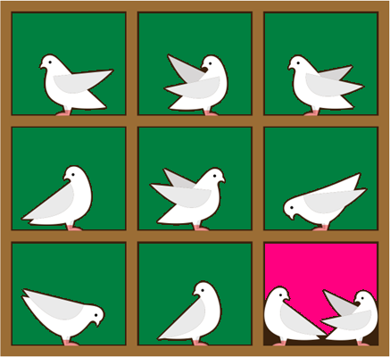
THE PIGEONHOLE PRINCIPLE
Its very useful principle for many counting problems.
Suppose that a flock of 10 pigeons flies into a set of 9 pigeonholes to roost. Because there are 10 pigeons but only 9 pigeonholes, at least one of these 9 pigeonholes must have at least two pigeons in it.

Slide 4
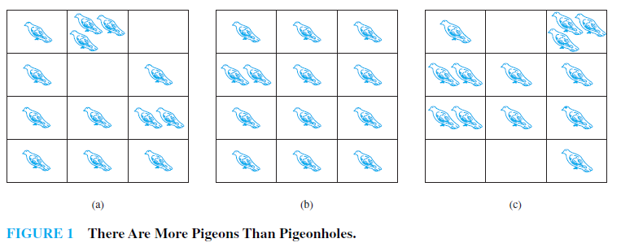
THE PIGEONHOLE PRINCIPLE
This illustrates a general principle called the pigeonhole principle, which states that if there are more pigeons than pigeonholes, then there must be at least one pigeonhole with at least two pigeons in it.

Slide 5
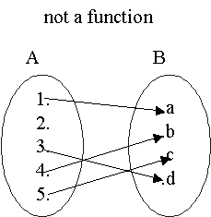
REVISION OF FUNCTIONS
Clearly the above relation is not a function because 2 does not have any image under this relation. Note that if want to made it relation we have to must map the 2 into some element of B which is also the image of some element of A.
Now

Slide 6
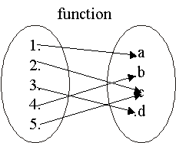
The above relation is a function because it satisfy the conditions of functions(as each element of 1st set have the images in 2nd set).

Slide 7
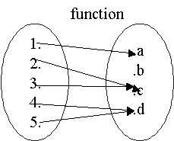
PIGEONHOLE PRINCIPLE
We define a function from A to B. If A has more elements then B.
B must have element which is image of more than one element of A.

Slide 8
PIGEONHOLE PRINCIPLE
A function from a set of k + 1 or more elements to a set of k elements must have at least two elements in the domain that have the same image in the co-domain.
If k + 1 or more pigeons fly into k pigeonholes then at least one pigeonhole must contain two or more pigeons.

Slide 9
EXAMPLES
1. Among any group of 367 people, there must be at least two with the same birthday. Why?
because there are only 366 possible birthdays.
2. In any set of 27 English words, there must be at least two that begin with the same letter. Why?
since there are 26 letters in the English alphabet.

Slide 10
EXERCISE
What is the minimum number of students in a class to be sure that two of them are born in the same month?
SOLUTION:
There are 12 (= n) months in a year.
The pigeonhole principle shows that among
any 13 (= n + 1) or more students there must be
at least two students who are born in the same month.

Slide 11
EXERCISE
a) Show that if 5 integers are selected from the first eight positive integers, there must be a pair of these integers with a sum equal to 9.
SOLUTION:
Group the first eight positive integers into four subsets of two integers each so that the integers of each subset add up to 9: {1, 8}, {2, 7}, {3, 6}, and {4, 5}.
If five integers are selected from the first eight positive integers, by the pigeonhole principle at least two of them come from the same subset. Two such integers have a sum of 9, as desired.
b) Is the conclusion true if 4 integers are selected rather than 5?
SOLUTION:
No. Take {1, 2, 3, 4}, for example.

Slide 12
EXERCISE
Show that from any set of seven integers, there must be two integers that have the same remainder when divided by 6?
SOLUTION:
The set of possible remainders that can be obtained when an integer is divided by six is {0, 1, 2, 3, 4, 5}.
This set has 6 elements.
Thus by the pigeonhole principle if 7 = 6 + 1 integers are each divided by six, then at least two of them must have the same remainder.

Slide 13
EXERCISE
How many integers from 1 through 100 must you pick in order to be sure of getting one that is divisible by 5?
SOLUTION:
There are 20 integers from 1 through 100 that are divisible by 5.
Hence there are 80 integers from 1 through 100 that are not divisible by 5.
Thus by the pigeonhole principle 81 = 80 + 1 integers from 1 though 100 must be picked in order to be sure of getting one that is divisible by 5.

Slide 14
EXERCISE
Let A = {1, 2, 3, 4, 5, 6, 7, 8, 9, 10}. Show that if six integers are chosen from A. Must there be two integers whose sum is 11.
SOLUTION:
The set A can be partitioned into five subsets:
{1, 10}, {2, 9}, {3, 8}, {4, 7}, and {5, 6} each consisting of two integers whose sum is 11.
These 5 subsets can be considered as 5 pigeonholes.
If you pick six elements. Then you have to pick one set from above sets.
If 6 = (5 + 1) integers are selected from A, then by the pigeonhole principle at least two must be from one of the five subsets. But then the sum of these two integers is 11.

Slide 15
Pigeonhole Principal … Exercise
At any given time in Lahore City there live at least two people who have the same number of hair on their head.

Slide 16
Pigeonhole Principal … Exercise
At any given time in Lahore there live at least two people who have the same number of hairs on their head.
A human has a maximum of about 500,000 hairs. In comparison, there are millions of people in a metropolitan, which outnumbers the number of hairs a human normally has. By pigeonhole principle, at least two of them must have the same number of hairs.

Slide 17

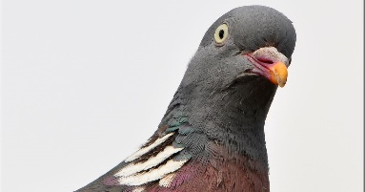
Pigeonhole Principal … Exercise
Formulating the Problem:
If there were no two people with the same number of strands of hair, then,
There would be at most one person having 0 strands,

Slide 18
Pigeonhole Principal … Exercise
Formulating the Problem
If there were no two people with the same number of strands of hair, then,
there would be at most one person having 0 strands,
at most one person having exactly 1 strand,

Slide 19
Pigeonhole Principal … Exercise
Formulating the Problem
If there were no two people with the same number of strands of hair, then,
there would be at most one person having 0 strands,
at most one person having exactly 1 strand,
and so on

Slide 20
Pigeonhole Principal … Exercise
Formulating the Problem
If there were no two people with the same number of strands of hair, then,
there would be at most one person having 0 strands,
at most one person having exactly 1 strand,
and so on
Finally, there would be at most one person having exactly 500,000 strands.

Slide 21
Pigeonhole Principal … Exercise
Formulating the Problem
If there were no two people with the same number of strands of hair, then,
there would be at most one person having 0 strands,
at most one person having exactly 1 strand,
and so on
Finally, there would be at most one person having exactly 500,000 strands.
But then this means that there are no more than 500,001 inhabitants of Lahore.

Slide 22


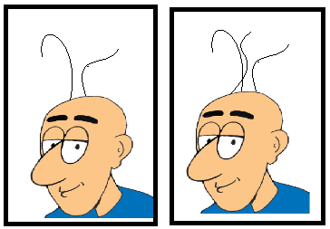
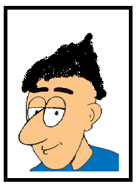
Pigeonhole Principal … Exercise
Imagine 500,001 enormous boxes (or pigeon holes)
The first one is labeled “Lahoris having 0 strands of hair,”
the next is labeled “Lahoris having 1 strand of hair,”
and so on.
The last box is labeled “Lahoris having 500,000 strands of hair”
If everybody goes to the proper box, then about 10 million Lahoris are properly assigned to some box (or hole).
Since we have only 500,001 boxes, there certainly will be a box containing more than one Lahori.

Slide 23
GENERALIZED PIGEONHOLE PRINCIPLE
A function from a set of n⋅k + 1 or more elements to a set of n elements must have at least k + 1 elements in the domain that have the same image in the co-domain.
If n ⋅ k + 1 or more pigeons fly into n pigeonholes then at least one pigeonhole must contain k + 1 or more pigeons.

Slide 24
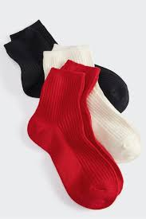
EXERCISE
Suppose a laundry bag contains many red, white, and black socks.
Find the minimum number of socks that one needs to choose in order to get two pairs (four socks) of the same color?

Slide 25
SOLUTION
Here there are n = 3 colors (pigeonholes)
and k + 1 = 4 or k = 3.
Thus among any n⋅k + 1 = 3⋅3 + 1 = 10 socks (pigeons),
at least four have the same color.

Slide 26
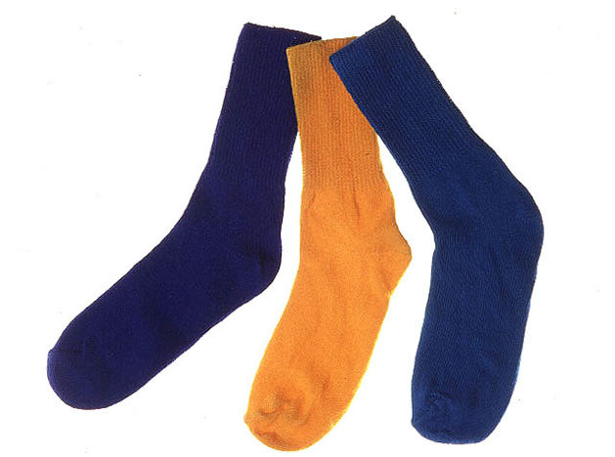
A Pair of Socks
EXERCISE … Do it Yourself
Assume you have 10 orange socks and 10 blue socks and you want to find a matching pair of socks from a Random pick. How many socks you will need to pick?
Assume you have 10 orange socks and 10 blue socks and you want to find a matching pair of blue socks from a Random pick. How many socks you will need to pick?

Slide 27

Let’s Play Cards …
EXERCISE
From a standard deck of 52 cards, how many cards you need to pick to guarantee at least two cards will be of the same color?
From a standard deck of 52 cards, how many cards you need to pick to guarantee at least two cards will be of the same suit?
From a standard deck of 52 cards, how many cards you need to pick to guarantee at least two cards will be Queens?

Slide 28
FLOOR & CEILING FUNCTIONS
Given any real number x, the floor of x, denoted ⎣x⎦, is the largest integer smaller than or equal to x.
Example: ⎣3.4⎦ = 3 and ⎣5⎦ = 5
Given any real number x, the ceiling of x, denoted ⎡x⎤, is the smallest integer greater than or equal to x.
Example: ⎡3.4⎤ = 4 and ⎡5⎤ = 5

Slide 29
EXAMPLE
Compute ⎣x⎦ and ⎡x⎤ for each of the following values of x.
a. 25/4 b. 0.999 c. –2.01
SOLUTION:
a. ⎣25/4⎦ = ⎣6 + ¼⎦ = 6
⎡25/4⎤ = ⎡6 + ¼⎤ = 6 + 1 = 7
b. ⎣0.999⎦ = ⎣0 + 0.999⎦ = 0
⎡0.999⎤ = ⎡0 + 0.999⎤ = 0 + 1 = 1
c. ⎣–2.01⎦ = ⎣–3 + 0.99⎦ = –3
⎡–2.01⎤ = ⎡–3+ 0.999⎤ = –3 + 1 = –2

Slide 30
PIGEONHOLE PRINCIPLE
If N pigeons fly into k pigeonholes then at least one pigeonhole must contain ⎡N /k⎤ or more pigeons.

Slide 31
EXAMPLE
We have 100 people and we want to know how many of them are born in same month?
Solution:
n = 12 months (pigeonholes)
The required no. is ⎡100/12⎤ = ⎡8 + 1/3⎤ = 9 who were born in the same month.

Slide 32
EXERCISE
What is the minimum number of students required in a Discrete Mathematics class to be sure that at least six will receive the same grade, if there are five possible grades, A, B, C, D, and F.
Solution:
Thus 26 is the minimum number of students needed to be sure that at least 6 students will receive the same grades.
5 grades * 5 people per grade +1 = 26 people

Slide 33
Practice Questions
How many students must be in a class to guarantee that at least two students receive the same score on the ﬁnal exam, if the exam is graded on a scale from 0 to 100 points?
How many students must be in a class to guarantee that at least 5 students receive the same score on the ﬁnal exam, if the exam is graded on a scale from 0 to 100 points?
How many people should be there to guarantee that 9 people are born in same month?
How many cards must be selected from a standard deck of 52 cards to guarantee that at least three cards of the same suit are chosen?
How many must be selected to guarantee that at least three hearts are selected?
How many students do you need in a school to guarantee that there are at least two students who have the same first two initials?
Given any 5 points inside a square of side length 2, there is always a pair whose distance apart is at most √2

Slide 34
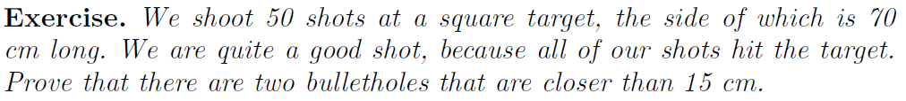
Examples: PHP --- Do it by yourself … EXAMPLE 10

Slide 35
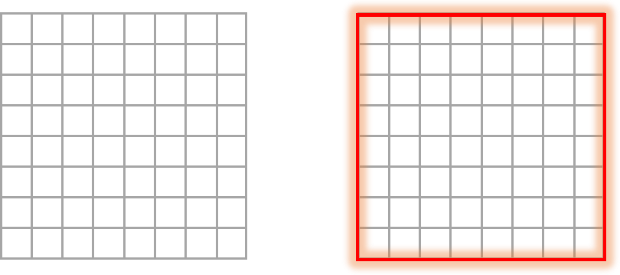
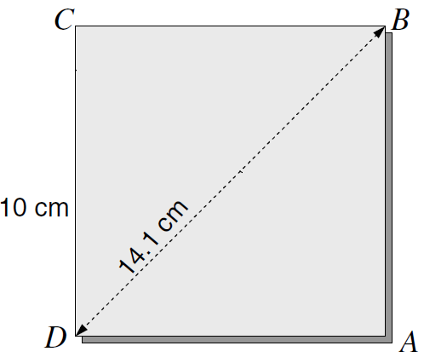
Example:
Examples: PHP --- Do it by yourself
From the textbook (Section 2.4 – Pages 35-36)

Slide 36
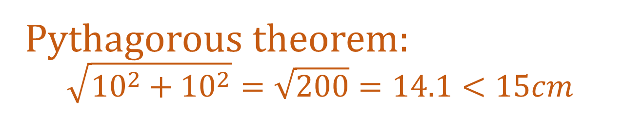
Pythagorous theorem: $$\sqrt{{10}^{2}+{10}^{2}}=\sqrt{200}=14.1<15cm$$
Examples: PHP --- Do it by yourself
Example:
From the textbook (Section 2.4 – Pages 35-36)

Slide 37
Examples: PHP --- Do it by yourself … EXAMPLE 11
What is the least number of area codes needed to guarantee that the 25 million phones in a state can be assigned distinct 10-digit telephone numbers?
(Assume that telephone numbers are of the form NXX-NXX-XXXX, where the ﬁrst three digits form the area code, N represents a digit from 2 to 9 inclusive, and X represents any digit.)

Slide 38
Examples: PHP --- Do it by yourself … EXAMPLE 11
What is the least number of area codes needed to guarantee that the 25 million phones in a state can be assigned distinct 10-digit telephone numbers?
(Assume that telephone numbers are of the form NXX-NXX-XXXX, where the ﬁrst three digits form the area code, N represents a digit from 2 to 9 inclusive, and X represents any digit.)
Ceil (25,000,000 / 8,000,000 )= 4

Slide 39
Examples: PHP --- Do it by yourself … EXAMPLE 12
Ten points are placed inside a unit equilateral triangle. Show that there exists two points with distance less than 1/3.

Slide 40
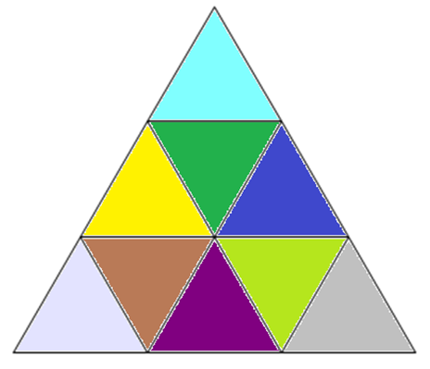
Examples: PHP --- Do it by yourself … EXAMPLE 12
Ten points are placed inside a unit equilateral triangle. Show that there exists two points with distance less than 1/3.
Solution:
Consider the partitioning of the given triangle into nine congruent equilateral triangles as shown below:

Slide 41
Section 6.3 Permutations & Combinations

Slide 42
Permutations
A permutation of a set of distinct objects is an ordered arrangement of these objects.
We are interested in ordered arrangements of some of the elements of a set.
An ordered arrangement of r elements of a set is called an r-permutation.
The number of r-permutations of a set with n elements is denoted by P(n, r). We can find P(n, r) using the product rule.
If n is a positive integer and r is an integer with 1 ≤ r ≤ n, then there are
P(n, r) = n(n − 1)(n − 2) · · · (n − r + 1)
r-permutations of a set with n distinct elements.

Slide 43
Permutations … Example
We have to pick a president and a secretary from a group of four candidates. How many different ways we can pick them?
Solution:
Group Size = n = 4
To be picked = r = 2
P(4, 2) = n.(n-1).(n-2)…..(n-r+1) = 4 . 3 = 12

Slide 44
Permutations … Exercises
How many ways are there to select a first-prize winner, a second-prize winner, and a third-prize winner from 100 different people who have entered a contest?
There are eight runners in a race. The winner receives a gold medal, the second-place finisher receives a silver medal, and the third-place finisher receives a bronze medal. How many different ways are there to award these medals, if all possible outcomes of the race can occur and there are no ties?
A saleswoman has to visit eight different cities. She must begin her trip in a specified city, but she can visit the other seven cities in any order she wishes. How many possible orders can the saleswoman use when visiting these cities?
How many permutations of the letters ABCDEFGH contain the substring ABC?

Slide 45
Permutations … Exercises
List all permutations of {1, 2, 3, 4}
How many permutations {a, b, c, d, e} end on ‘c’?
List all 3-permutations of {1, 3, 5, 7, 9}.
In how many different orders can five runners finish a race if no ties are allowed?
How many possibilities are there for the win, place, and show (first, second, and third) positions in a horse race with 12 horses if all orders of finish are possible (no ties)?
There are six different candidates for governor of a state. In how many different orders can the names of the candidates be printed on a ballot?
How many bit strings of length 10 contain
exactly four 1s?
at most four 1s?
at least four 1s?
an equal number of 0s and 1s?

Slide 46
Permutations … Exercises
A group contains n men and n women. How many ways are there to arrange these people in a row if the men and women alternate?
In how many ways can a set of two positive integers less than 100 be chosen?
In how many ways can a set of five letters be selected from the English alphabet?
A coin is flipped eight times where each flip comes up either heads or tails. How many possible outcomes
are there in total?
contain exactly three heads?
contain at least three heads?
contain the same number of heads and tails?
How many permutations of the letters ABCDEFG contain
the string BCD?
the string CFGA?
the strings BA and GF?
the strings ABC and DE?
the strings ABC and CDE?
the strings CBA and BED?

Slide 47
Permutations with Repetitions
The number of r-permutations of a set of n objects with repetition allowed is n^{r}.

Slide 48
Permutations with Repetitions … Exercises
How many strings of length r can be formed using letters A – Z?
How many ways can we pick 5 fruits from four fruit baskets containing apples, bananas, mangoes and peaches respectively? Each basket contains 10 fruits.
How many ways can we pick five bills of Rs. 50, Rs. 100, Rs. 500, Rs. 1000 and Rs. 5000? Given that we have more than five currency notes of very denomination.

Slide 49

Combinations
When we choose k objects out of n, in how many ways we can choose?
$$\left(\begin{aligned}n \\ k\end{aligned}\right)=\frac{n!}{k!\left(n−k\right)!}$$

Slide 50
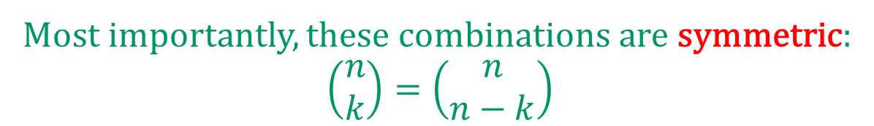
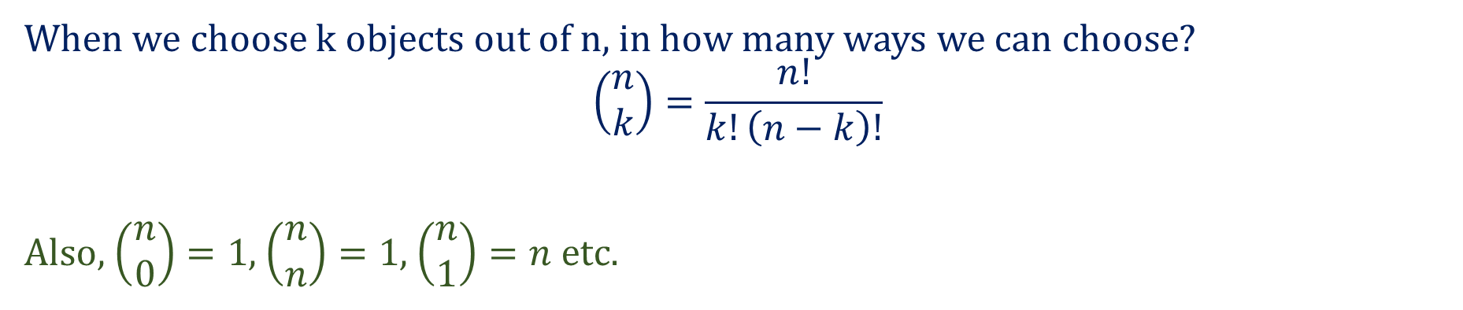
Combinations
When we choose k objects out of n, in how many ways we can choose?
$$\left(\begin{aligned}n \\ k\end{aligned}\right)=\frac{n!}{k!\left(n−k\right)!}$$
Also, $\left(\begin{aligned}n \\ 0\end{aligned}\right)=1$, $\left(\begin{aligned}n \\ n\end{aligned}\right)=1$, $\left(\begin{aligned}n \\ 1\end{aligned}\right)=n$ etc.
Most importantly, these combinations are symmetric:
$$\left(\begin{aligned}n \\ k\end{aligned}\right)=\left(\begin{aligned}n \\ n−k\end{aligned}\right)$$

Slide 51
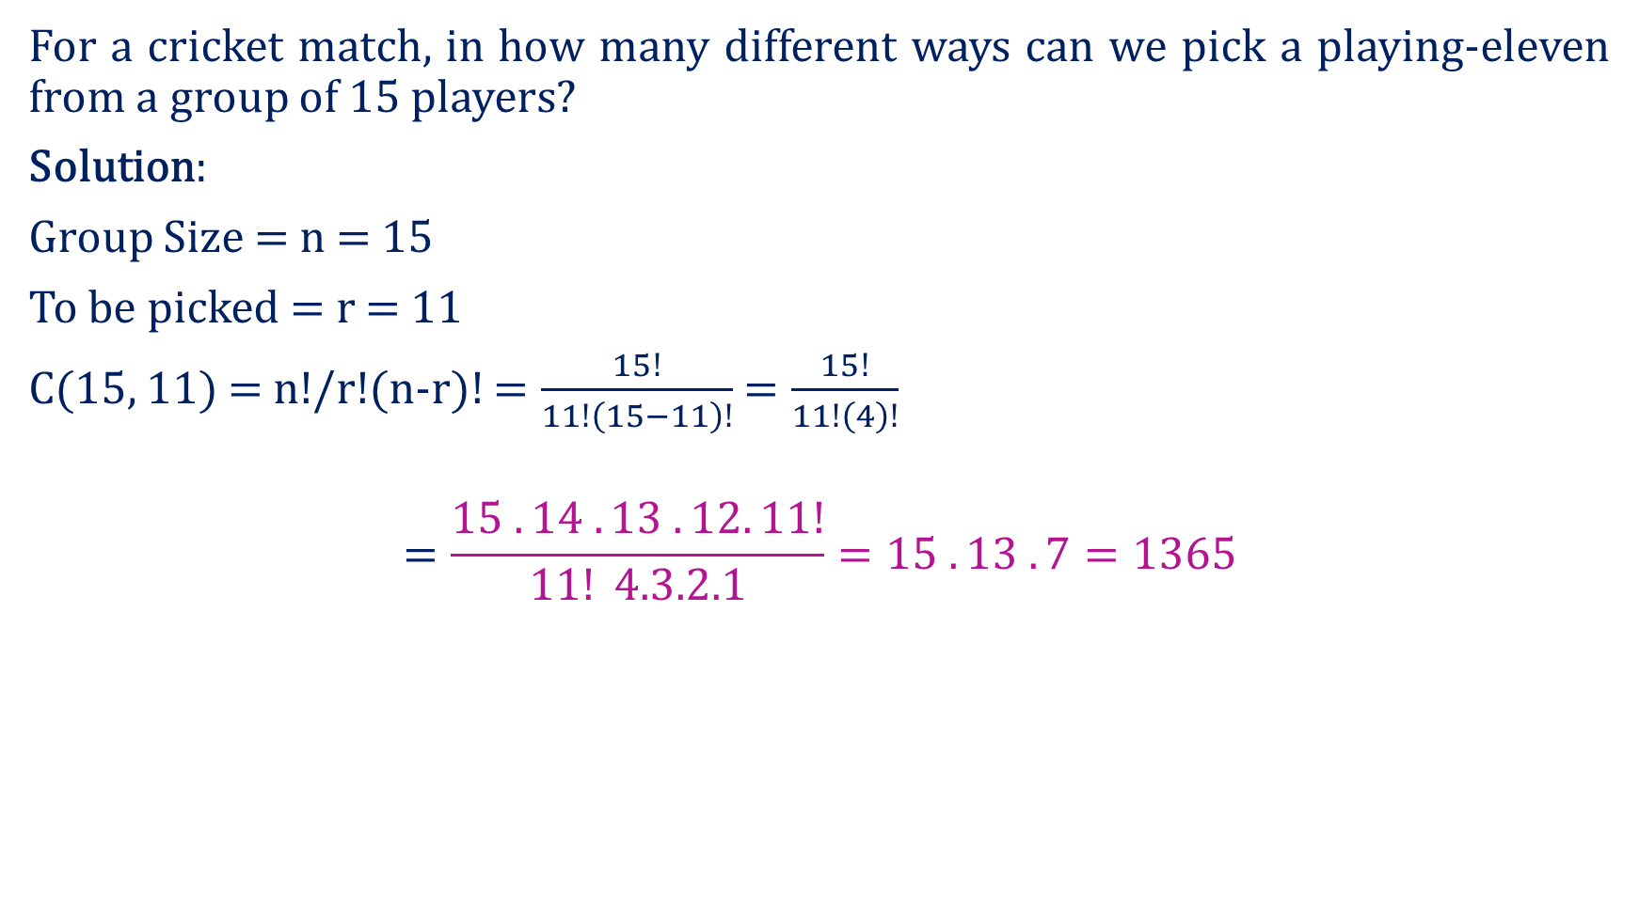
Combinations … Example
For a cricket match, in how many different ways can we pick a playing-eleven from a group of 15 players?
Solution:
Group Size = n = 15
To be picked = r = 11
C(15, 11) = n!/r!(n-r)! $=\frac{15!}{11!\left(15−11\right)!}$ $=\frac{15!}{11!\left(4\right)!}$
$$=\frac{15 . 14 . 13 . 12. 11!}{11! 4.3.2.1}=15 . 13 . 7=1365$$

Slide 52
Combinations … Exercises
For a cricket match, in how many different ways can we pick a playing-eleven from a group of 15 players? Given that there is only one wicket keeper among the 15 players and he must be chosen.
We have to choose 5 members of a trade committee from the house of representatives containing 100 members. How many different ways we can do it?
There are ten women and 12 men available in a party. They are going to play a game with five players. At least two women must play the game. How many different ways can we choose players?
Alika must pick two elective courses out of eight that are offered. In how many ways can she pick two courses when she will not pick a course named UI/UX Design?

Slide 53
Combinations with Repetitions
Example:
Solution:
n = 7, r = 5

Slide 54
Permutations with Repetitions … Exercises
A bakery has four types of cookies. In how many ways can we pick six cookies? Assume that there are more than six cookies available for each type of cookies. Moreover, the cookies of one type are indistinguishable.
How many solutions of the equation x + y + z = 11 are possible where x, y and z are non-negative integers?
How many solutions of the equation x + y + z = 11 are possible where x, y and z are non-negative integers? Given that x ≥ 1, y ≥ 2 and z ≥ 3.

Slide 55
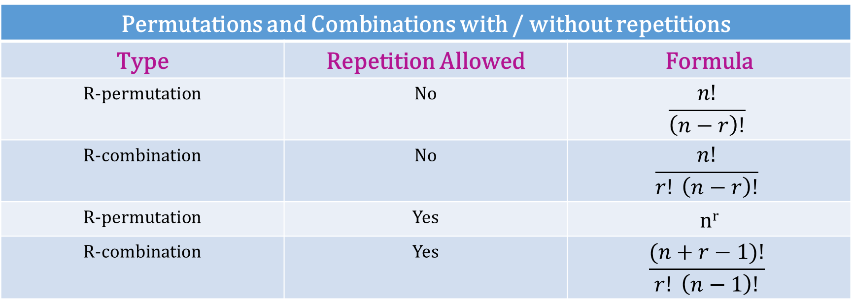
Permutations and Combinations … Summary
Permutations and Combinations with / without repetitions
Type | Repetition Allowed | Formula
R-permutation | No | $$\frac{n!}{\left(n−r\right)!}$$
R-combination | No | $$\frac{n!}{r! \left(n−r\right)!}$$
R-permutation | Yes | n^{r}
R-combination | Yes | $$\frac{(n+r−1)!}{r! \left(n−1\right)!}$$

Slide 56

Summary
The topics we covered:
Pigeonhole Principle
Ceiling and floor function
Practice Questions

